Slide 1

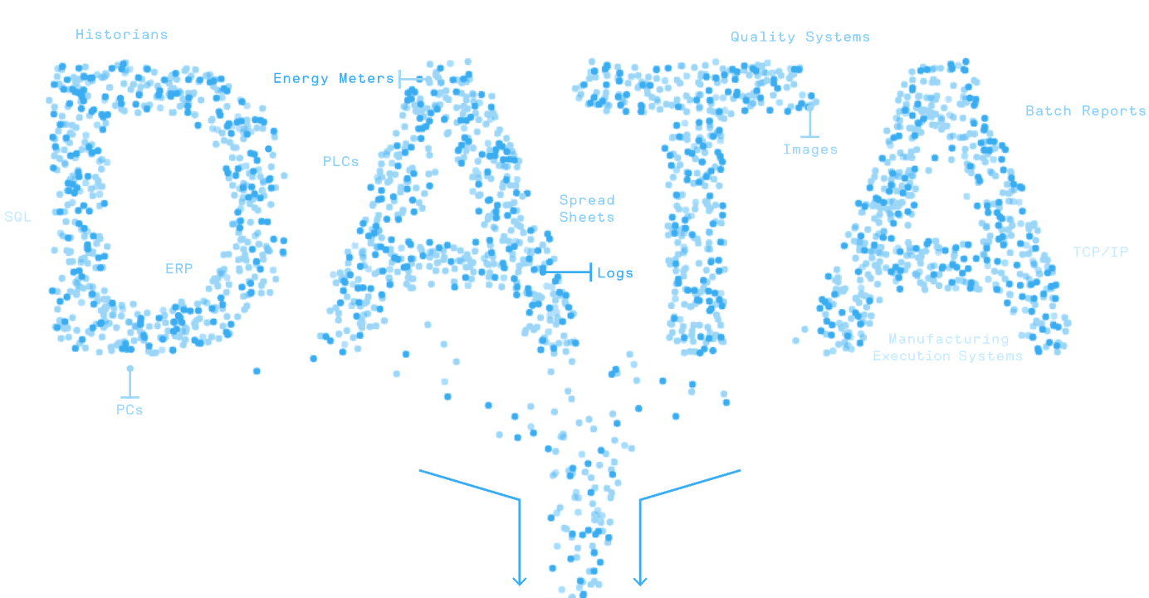
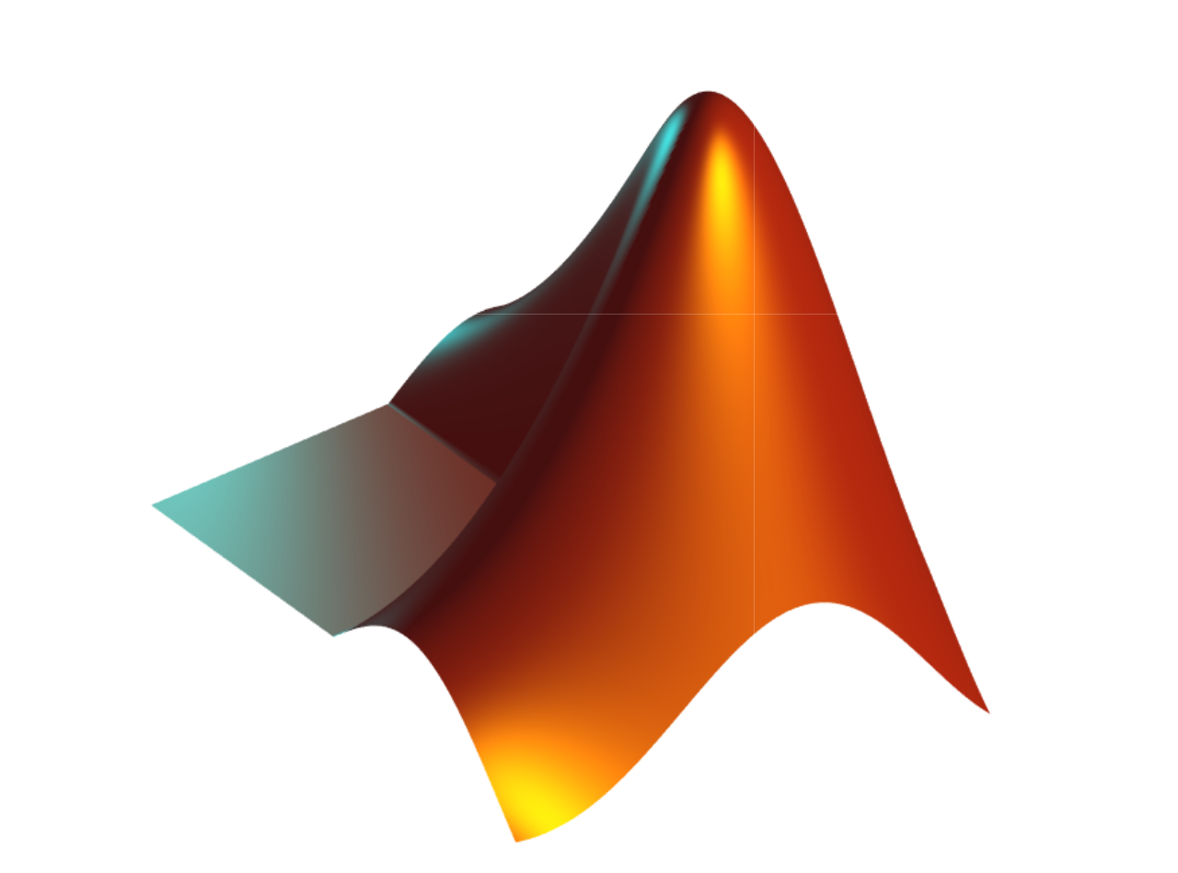
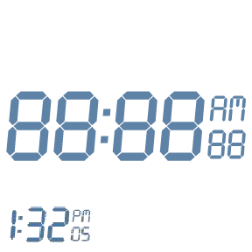
MATLAB Fundamental Laboratory Handbook (MATLAB)
Chapter 8 Graphics and Data Visualisation
Dr Leo Chen
leo.chen@ieee.org
1

Slide 2
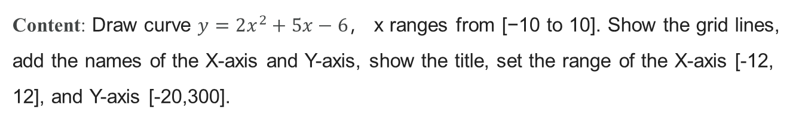
8. 1 Lab
Objective: Draw a 2D plot.
Content: Draw curve $y=2x^{2}+5x−6$， x ranges from [−10 to 10]. Show the grid lines, add the names of the X-axis and Y-axis, show the title, set the range of the X-axis [-12, 12], and Y-axis [-20,300].
x = -10:0.1:10;
y = 2*x.^2+5*x-6;
plot(x,y);
grid on
xlabel("x")
ylabel("y")
title("curve y = 2x^2 + 5x−6")
axis([-12, 12, -20, 300])

Slide 3
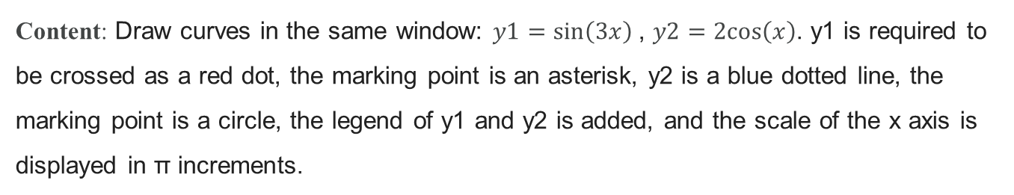
8. 2 Lab
Objective: Draw multiple plots.
Content: Draw curves in the same window: $y1=\sin\left(3x\right)$, $y2=2cos\left(x\right)$. y1 is required to be crossed as a red dot, the marking point is an asterisk, y2 is a blue dotted line, the marking point is a circle, the legend of y1 and y2 is added, and the scale of the x axis is displayed in π increments.
x = 0:0.1:4*pi;
y1 = sin(3*x);
y2 = 2*cos(x);
plot(x, y1, '-.*r', x, y2, '--ob');
legend('y1=sin(3x)','y2=2cos(x)')
xticks(0:pi:4*pi)
xticklabels({'0','\pi','2\pi','3\pi','4\pi'})

Slide 4
8. 3 Lab
Objective: Draw a subplot.
Content: In one figure window, draw the curves of sine function, cosine function, tangent function and cotangent function, respectively.
x = 0:pi/50:2*pi;
k = [1 26 51 76 101]; % Singular points of tangent and cotangent
x(k) = [];
subplot(2,2,1);
plot(x,sin(x));
title('y=sin(x)');
subplot(2,2,2);
plot(x,cos(x));
title('y=cos(x)');
subplot(2,2,3);
plot(x,tan(x));
title('y=tan(x)');
subplot(2,2,4);
plot(x,cot(x));
title('y=cot(x)');

Slide 5

8. 4 Lab
Objective: Draw 3D plots.
Content: In one figure window, draw the 3D line graph, mesh surface graph, and surface graph for function $z=x^{4}+{\left(y−0.4\right)}^{4}−xy$ .
[x, y] = meshgrid(-10:1:10);
z = x.^4 - (y-0.4).^4 - x*y;
subplot(1,3,1);
plot3(x, y, z);
title('plot3');
subplot(1,3,2);
mesh(x, y, z);
title('mesh');
subplot(1,3,3);
surf(x, y, z);
title('surf');

Slide 6
8. 5 Lab
Objective: Draw Data Distribution Plots.
Content: A company paid the following salaries this month: 8200 12200 9000 6850 7800 8500 7500 4800 9200 7600 6250 10800 11500 8200 11000 12800 7800 7250 7500 8600 8200 6300 12000 6500 7800 5500 6600 7500 8200 9000 6800 8300 7800 8500 7500 4800 9100 6800 7600 15000 6500 8200 20000 9800 7800 18000 10500 5700 7500 8200 6000 6800 7800 5500 7900 5500 7500 7000 7100 5800, calculate its average, plot its histogram, and count the number of people with a salary greater than 10,000.
salary = [8200 12200 9000 6850 7800 8500 7500 4800 9200 7600 6250 10800 ...
11500 8200 11000 12800 7800 8250 7500 8600 8200 6300 12000 ...
6500 7800 5500 6600 7500 8200 9000 6800 8300 7800 8500 7500 4800 ...
9100 6800 7600 15000 6500 8200 20000 9800 7800 18000 10500 5700 ...
7500 8200 6000 6800 7800 5500 7900 5500 7500 7000 7100 5800];
average = mean(salary);
x = 4000:2000:20000;
histogram(salary, x);
num = length(find((salary>=10000)));
disp(average);
disp(num);

Slide 7
8. 6 Lab
Objective: Draw a discrete data plot.
Content: Randomly generate a 100*4 array, and then draw a scatter plot containing solid diamond marks, with the first column in horizontal coordinates, the second column in vertical coordinates, (third column *50) specifying the size of the symbol, (fourth column *10) specifying the color.
data = rand(100,4);
x = data(:,1);
y = data(:,2);
sz = 40 * data(:,3);
color = 10 * data(:,4);
scatter(x,y,sz, color, 'filled', 'd');

Slide 8
8. 7 Lab
Objective: Draw Vector Fields Plots.
Content: Draw two dimensional and three-dimensional vector diagrams for $z=y^{2}{−x}^{2}$.
[x, y] = meshgrid(-3:0.5:3, -3:0.5:3);
z = y.^2 - x.^2;
[u, v] = gradient(z, 2, 2);
quiver(x, y, u, v);
[u, v, w] = surfnorm(z);
quiver3(z, u, v, w);

Slide 9
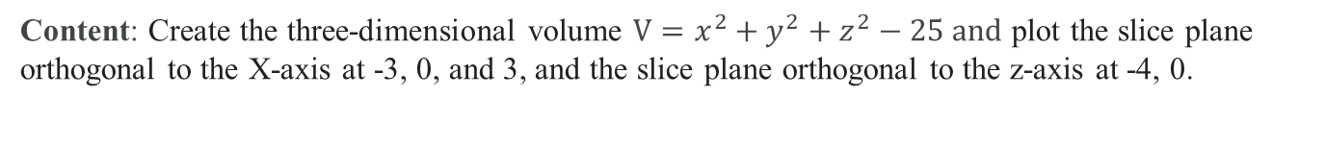
8. 8 Lab
Objective: Practice Volume Visualization.
Content: Create the three-dimensional volume ${V=x}^{2}+y^{2}+z^{2}−25 and$ plot the slice plane orthogonal to the X-axis at -3, 0, and 3, and the slice plane orthogonal to the z-axis at -4, 0.
[x,y,z]=meshgrid(-5:0.5:5);
V = x.^2 + y.^2 + z.^2 - 25;
xslice = [-3 0 3];
yslice = [];
zslice = ([-4 0]);
slice(x, y, z, V, xslice, yslice, zslice)
cb = colorbar;

